Slide 1
PROJECT 1 PRESENTATION
Presented by
Kamesh V R

Slide 2


Expense Reimbursement System
This application is used by Bharathinfo.msdk and it's a web application were the firm's employees are going to benefiters while using this user interface application as it's user friendly.
This application have some web pages which will be interactive to the users and also their personal details are secured.
This application mainly focus on the Reimbursement requests which are given by different employees which will be stored in database and an admin can approve or deny the reimbursement requests.

Slide 3
This Project is developed with Servlet and with MySQL Database.
This Project use a design pattern for the development. With the help of design pattern the flow of program can be easily monitored.
The list of packages created :
Model
Entity
Controller
Service
DAO (Data Access Object)
Exception
Util
Mapper

Slide 4

Java OOP
Collections
Control Statements
Exceptions
Maven Project
Hibernate
SQL
Servlet
HTML
CSS
Bootstrap
Java 1.8
Log4j
Junit
Tomcat Server
MySQL Database
Concepts and technologies Covered with this application are :

Slide 5
Features and Requirements
For Employee :
Registration or Sign up Validation
Login Validation
Employee Home Page
Reimbursement Application
All Reimbursement request for particular employee
View personal profile
Update personal profile
For Manager:
Registration or Sign up Validation
Login Validation
Manager Home Page
View every Reimbursement Requests of employees
View pending Reimbursement Requests and approve/deny pending Reimbursement Requests
View all pending Reimbursement Requests
View all approved Reimbursement Requests
View all denied Reimbursement Requests

Slide 6
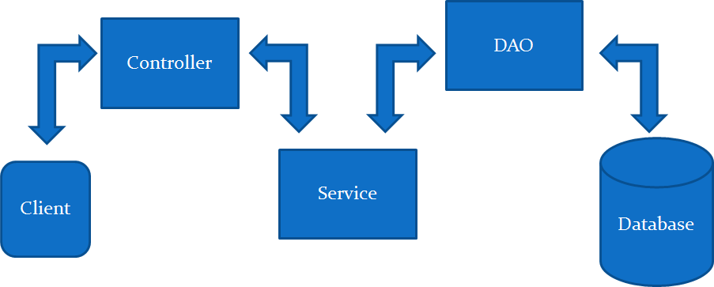

Slide 7
Table Name: EmployeeDetails one to many relationship
Table Name: ReimbursementDetails
Column Names | Data Types & Constraints
Employee_id | Varchar Primary key
Password | Varchar not null, unique
First_Name | Varchar
Last_Name | varchar
Department | varchar
Designation | varchar
Email_Id | Varchar not null, unique
Phone_no | long unique
Type | varchar
Column Names | Data Types & Constraints
Reimbursement_id | Auto increment Primary key
Employee_id | Varchar foreign key
Reimbursement Type | Varchar
Reimbursement_Amount | Double
Description | varchar
Invoice_Documents | longblob
Reimbursement_Status | Varchar

Slide 8
THANK YOU

